Slide 1
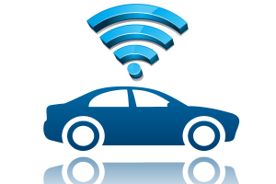
Smart Drive
Iot based solution to minimize the accidents and loss of lives

Slide 2
Problem Statement
While developing Smart Cities, we need to consider increasing traffic congestion and tackle accidents.
Accidents can be avoided if we address road safety in holistic manner with involvement from multiple sectors such as transport, health, weather conditions and real-time traffic monitoring.
Internet of Things (IoT) will play a key role in implementing Smart & Safe Drive to minimize the accidents and eventually minimize the loss of lives.
If we can monitor vehicle condition, driver’s health, weather forecast, health services and continuous traffic, then we can reduce the probability of accident by analysing the situation.

Slide 3
Feasible Solution
Monitor the sensor inputs from different wearable devices and connected devices in car
Analyzing sensor data with weather forecast and traffic congestion to reduce the probability of accident.
Alert health services in case of emergency.
Ensure help reaches the spot quickly.
Regulate traffic.
Understand the accident cases by real time monitoring and figure out major accident causes.
Analyzed data can be used for future safety.

Slide 4
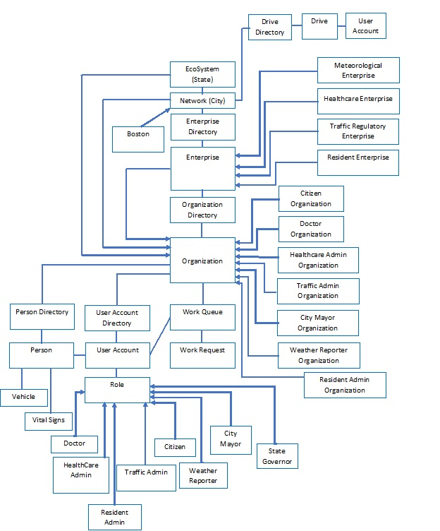
System Object Model

Slide 5
Roles Involved
Citizen: Driver of the vehicle
Doctor: Grant appointment and provide medication to Citizen
Healthcare Admin: Approve ambulance request, dispatch it and alert the Traffic Admin
Traffic Admin: Alert Citizens regarding Ambulance on way and traffic congestion.
Weather Reporter: Analyze and report the weather conditions.
City Mayor: Monitor overall accident scenarios and analyze the cases for probable solution.

Slide 6
Key Features
Read wearable devices input and analyze health condition of Citizen.
Monitor vehicle's condition by sensing data such as Air Pressure, Speed, Engine, Brake.
Request ambulance in case of emergency.
Issue en route Ambulance alert for quicker assistance in emergency.
Monitor accident cases and analyze data.
Generate probability and main causes behind accidents.

Slide 7
Extra Feature
Request Doctor appointment if Citizen observes abnormal health.
Report maintenance team via email, if vehicle needs attention.
Real time monitoring.

Slide 8
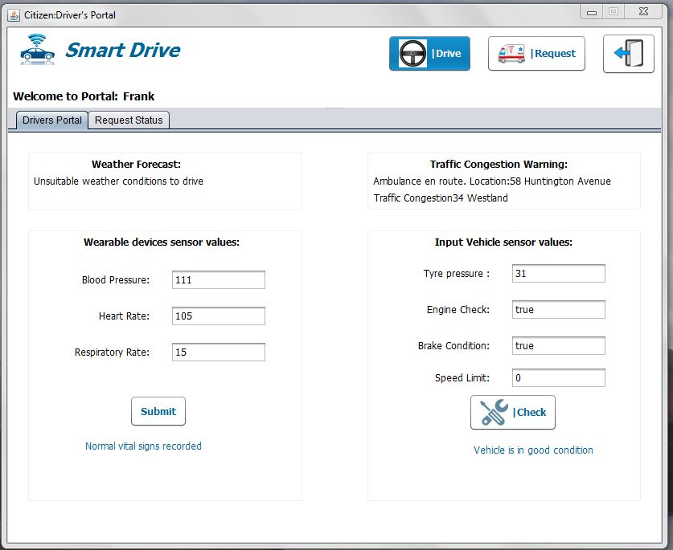
Citizen Portal

Slide 9
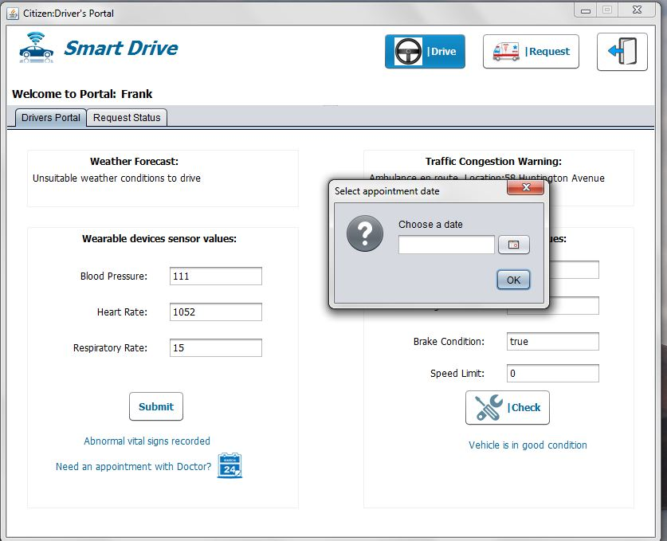
Request doctor appointment

Slide 10
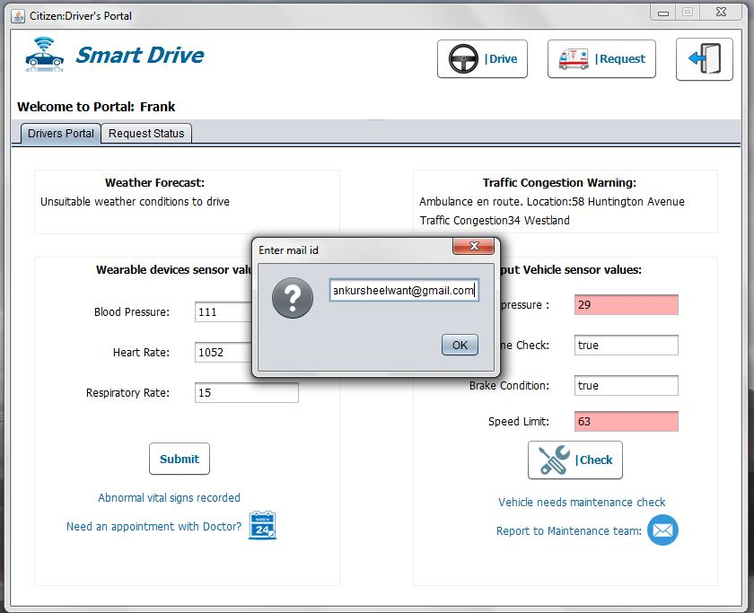
Mail to Maintenance Team

Slide 11
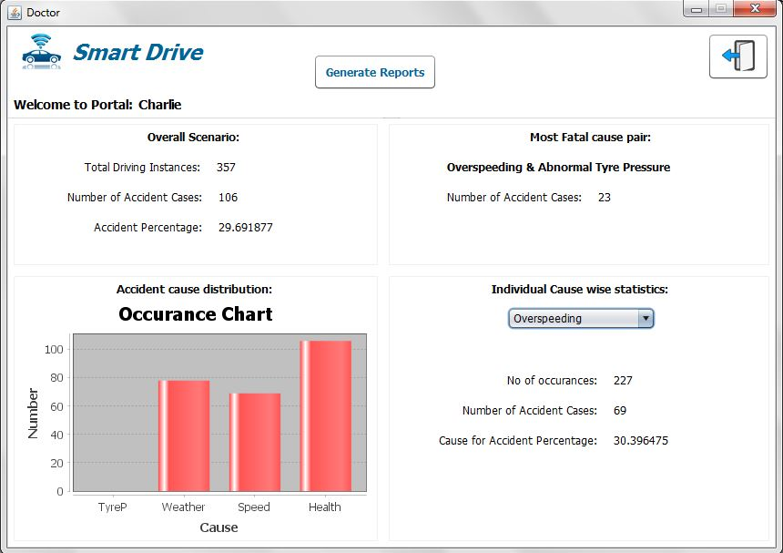
Analyzed Results

Slide 12
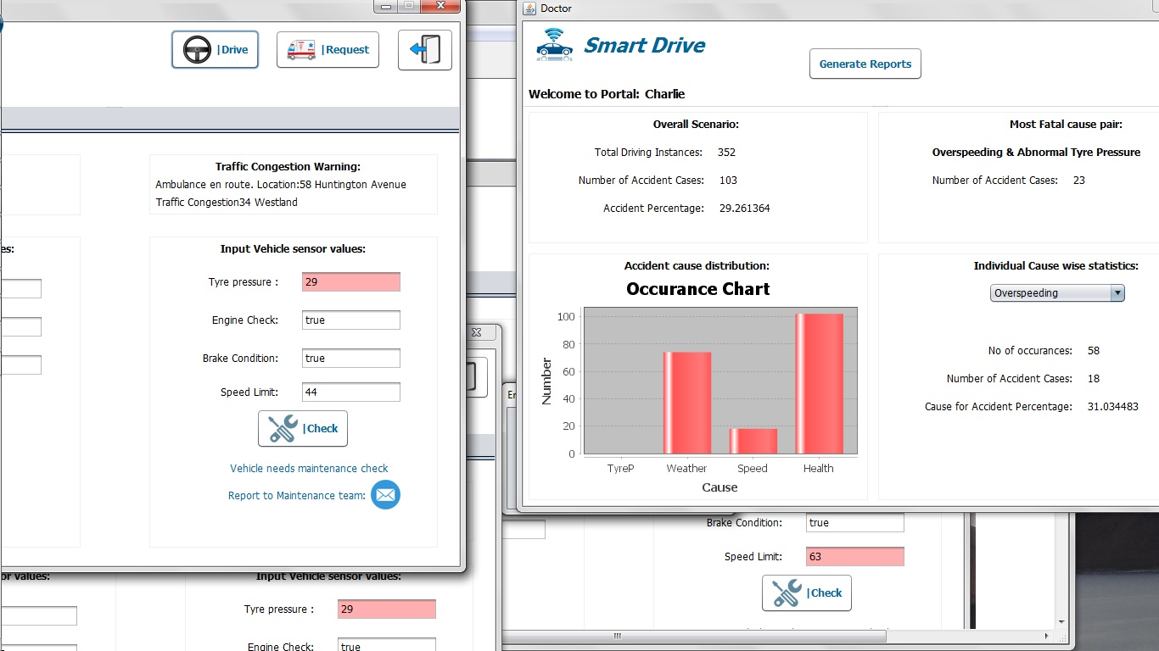
Real Time Monitoring

Slide 13
Thank You.

